Slide 1
Title: Human Detection in Disaster Scenarios using Yolov11 Student Name:Dinesh chintakindi and Student ID:22010553
Aim:
The aim of this project is to develop a robust deep learning system for human detection in disaster scenarios using the Yolov11 model. The preprocessing steps include Bilateral Filtering to reduce noise and Histogram Equalization to enhance image contrast. These techniques will improve the clarity of human figures in challenging environments, such as low light and noisy conditions, ensuring accurate and reliable detection to aid in rescue operations.
Research questions:
How does Yolov11's Bilateral Filtering noise reduction approach affect human detecting accuracy in crisis scenarios?
How can Histogram Equalization enhance human visibility in disasters with poor light or strong contrast?
What impact does Bilateral Filtering and Histogram Equalization have on Yolov11's ability to distinguish persons in clutter?
How does the Yolov11 model compare to other state-of-the-art models for real-time person identification in catastrophe situations given the specified preprocessing steps?
Objective of the project:
Develop a Yolov11-based deep learning model for human detection in catastrophe scenarios.
Utilize Preprocessing Methods: Use Bilateral Filtering to minimize noise and Histogram Equalization to boost picture contrast for better detection in difficult settings.
Assess Model Performance: Evaluate Yolov11's ability to recognize persons in various catastrophe situations, including low-light and noisy conditions, after preprocessing.
Compare Yolov11 to Baseline Models: Evaluate accuracy, speed, and robustness performance against other top object detection models.
Background:
Dong, J et al. (2020) collected a new thermal image dataset using UAVs and trained pedestrian detection models with YOLOV3, YOLOV3-MobileNetV1, and YOLOV3-MobileNetV3 for post- disaster SAR, achieving 26.60 FPS on NVIDIA's Jetson TX2 after pruning and fine-tuning for optimal inference. Pi, Y., et al. (2020) used Volan2018 with eight hurricane movies (65,580 frames) to test CNN models for recognizing vital ground assets from aerial views. Transfer learning CNNs on YOLO got 80.69% mAP for helicopter video and 74.48% for drone footage. Lee, H.W., et al. (2022) developed an HHD strategy integrating YOLO with RetinaNet for high human detection rates in interior catastrophes, notably through fire smoke, enabling quicker and more accurate victim identification.
Reference:
Lee, H.W., Lee, K.O., Bae, J.H., Kim, S.Y. and Park, Y.Y., 2022. Using hybrid algorithms of human detection technique for detecting indoor disaster victims. Link:https://www.mdpi.com/2079- 3197/10/11/197
Pi, Y., Nath, N.D. and Behzadan, A.H., 2020. Convolutional neural networks for object detection in aerial imagery for disaster response and recovery. Link:https://www.sciencedirect.com/science/article/abs/pii/S1474034619305828

Slide 2
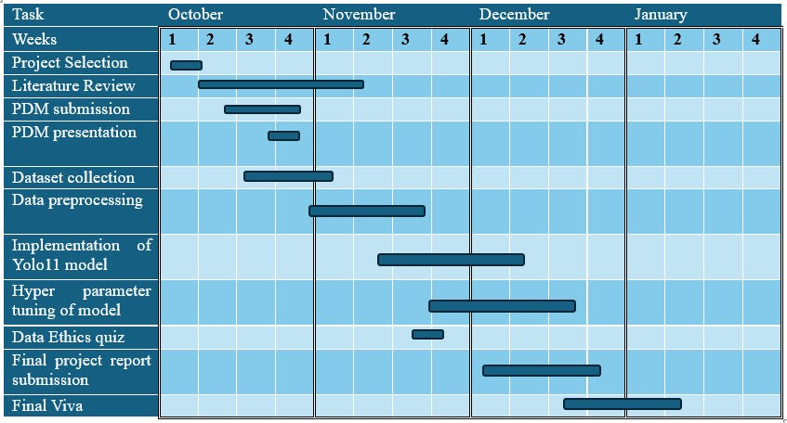
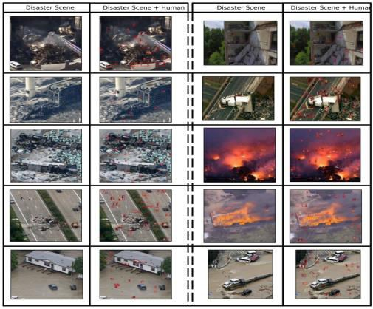
Dong, J., Ota, K. and Dong, M., 2020, December. Real-time survivor detection in UAV thermal imagery based on deep learning. Link:https://ieeexplore.ieee.org/abstract/document/9394263
Project plan
The October–January project plan comprises project selection, literature review, and PDM submission/presentation in October. Dataset collection and preparation occur late October–mid- November. Mid-November to early December will see Yolo11 model implementation and hyperparameter optimization. Late November has the Data Ethics quiz. December and early January are the final project report and viva dates.
Figure 1: Ghant chart for the project.
Overview of the Dataset
Search and rescue efforts during natural disasters and crises need speedy and precise human detection. The C2A dataset addresses this demand by offering a comprehensive resource for training AI algorithms to recognize humans in disasters. This trove of actual catastrophe photos and different human stances helps academics build more
reliable detection methods.
The AIDER (Aerial Image Dataset for Emergency
Response databases collection
Applications) and LSP/MPII-MPHB form the C2A dataset. The AIDER provides realistic catastrophe scene
pictures, whereas the LSP/MPII-MPHB dataset provides human body locations. This integration makes the dataset more useful for constructing disaster-ready AI systems.
Figure 2: Sample images from the dataset.
Data Collection
The C2A dataset can be accessed online through Kaggle, a popular platform for data science and machine learning projects. The direct link to the dataset is C2A Dataset on Kaggle (https://www.kaggle.com/datasets/rgbnihal/c2a-dataset). Additionally, the dataset is discussed in a

Slide 3
research paper, which can be accessed here (https://arxiv.org/pdf/2408.04922). These resources provide vital context and background for the dataset, supporting its relevance and application in disaster response scenarios.
Metadata
Over 360,000 annotated human cases are in 10,215 high-resolution C2A photos. It comprises five human poses—Bent, Kneeling, Lying, Sitting, and Upright—and four catastrophe scenarios— Fire/Smoke, Flood, Collapsed Building/Rubble, and Traffic Accidents. To cover a broad range of visual backgrounds and human positions, the photographs range in resolution from 123x152 pixels to 5184x3456 pixels. The bounding box annotations for each human instance are crucial for detection algorithm training. Given the large number of photos and annotations, the dataset may reach several terabytes.
Document Control
I plan to keep the project code on GitHub (Github link), where I will contribute changes on a weekly basis. To provide clarity and change traceability, the GitHub repository will be arranged using a methodical file naming and version control approach. We'll change the repository's permissions to public so that contributors and markers may see the code.
ReadMe File
A ReadMe file will be added to the GitHub repository at the end of the project. This file will provide suggestions for duplicating the findings, instructions for executing the code, and important dataset information. For other developers who want to use or expand the project, it will be a useful reference.
Security and Storage
Biweekly regular backups of the code and dataset will be carried out to guarantee data security. Using GitHub and OneDrive, data will be safely shared with staff and markers, offering many levels of access and backup. This strategy will guarantee continuous availability while reducing the chance of data loss.
Ethical Requirements
GDPR Compliance: The C2A dataset does not contain personally identifiable information (PII), thereby meeting GDPR requirements.
Conformance to Ethical Policies: The project aligns with UH ethical policies, focusing on the responsible use of AI in humanitarian contexts.
Permission to Use Data: The dataset is publicly accessible on Kaggle, and usage for research purposes is permitted as stated in the associated documentation.
Ethical Data Collection: The original datasets were collected ethically, sourced from established research organizations, ensuring compliance with ethical standards in data collection and use.
Link to license: https://www.mit.edu/~amini/LICENSE.md

